Slide 1
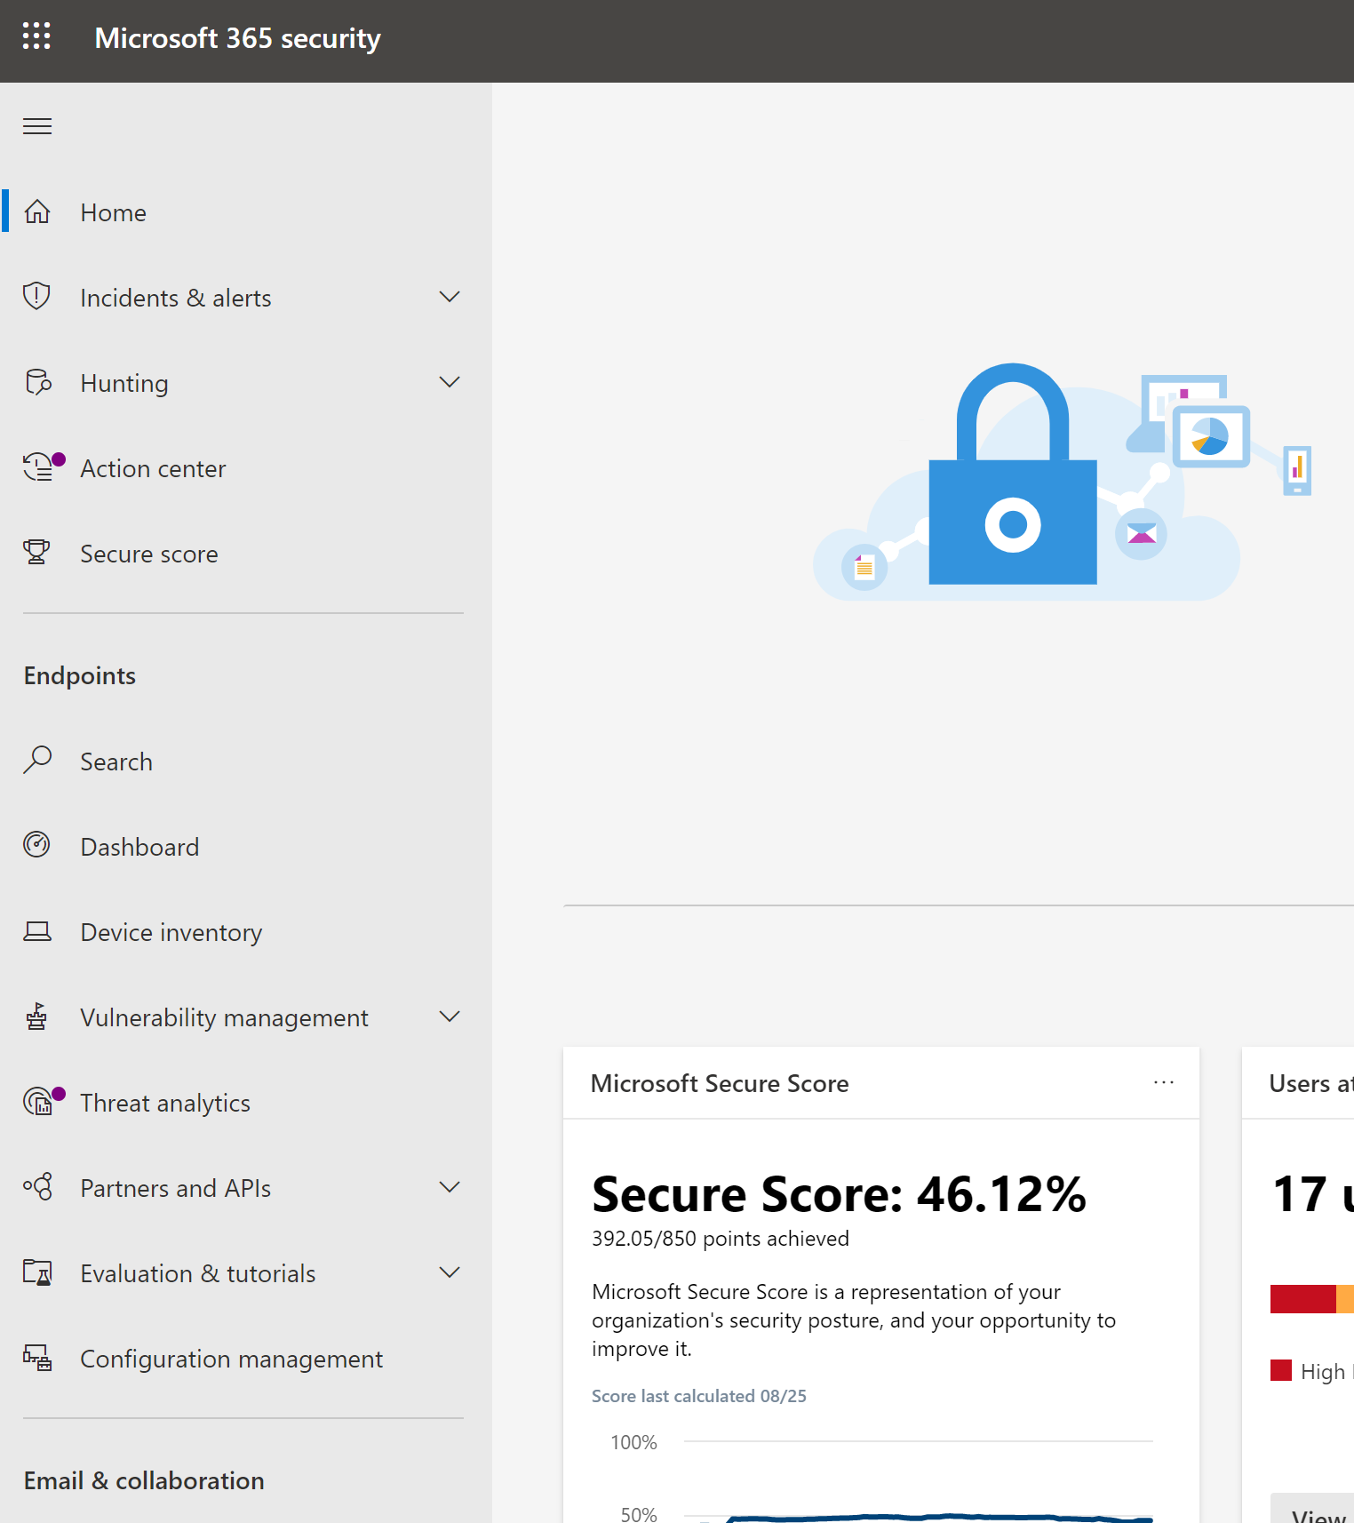
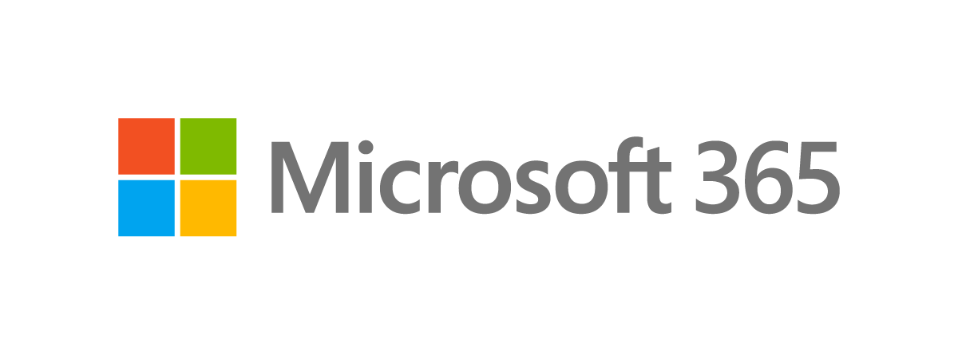
Investigate Security Incidents with Microsoft Defender for Endpoint
Microsoft 365 Defender
Heike Ritter (@heikeritter) Program Manager, Microsoft 365 Defender / Microsoft Defender for Endpoint Engineering

Slide 2

Microsoft Defender
for Endpoint
Built-in. Cloud-powered.
THREAT & VULNERABILITY MANAGEMENT
ATTACK SURFACE
REDUCTION
NEXT GENERATION
PROTECTION
ENDPOINT DETECTION
& RESPONSE
AUTO INVESTIGATION
& REMEDIATION
MICROSOFT
THREAT EXPERTS
CENTRALIZED CONFIGURATION AND ADMINISTRATION
APIS AND INTEGRATION
Embedded into the OS
World class anti-tampering
Deep data collection & 6m storage
Best of breed EPP , EDR
Support for W7/8, non-Windows
Integrated configuration management
Vulnerability analysis
Secure score &
Configuration Assessment
Automation
Cross suite integrations
Data separation, RBAC
Cloud expertise

Slide 3
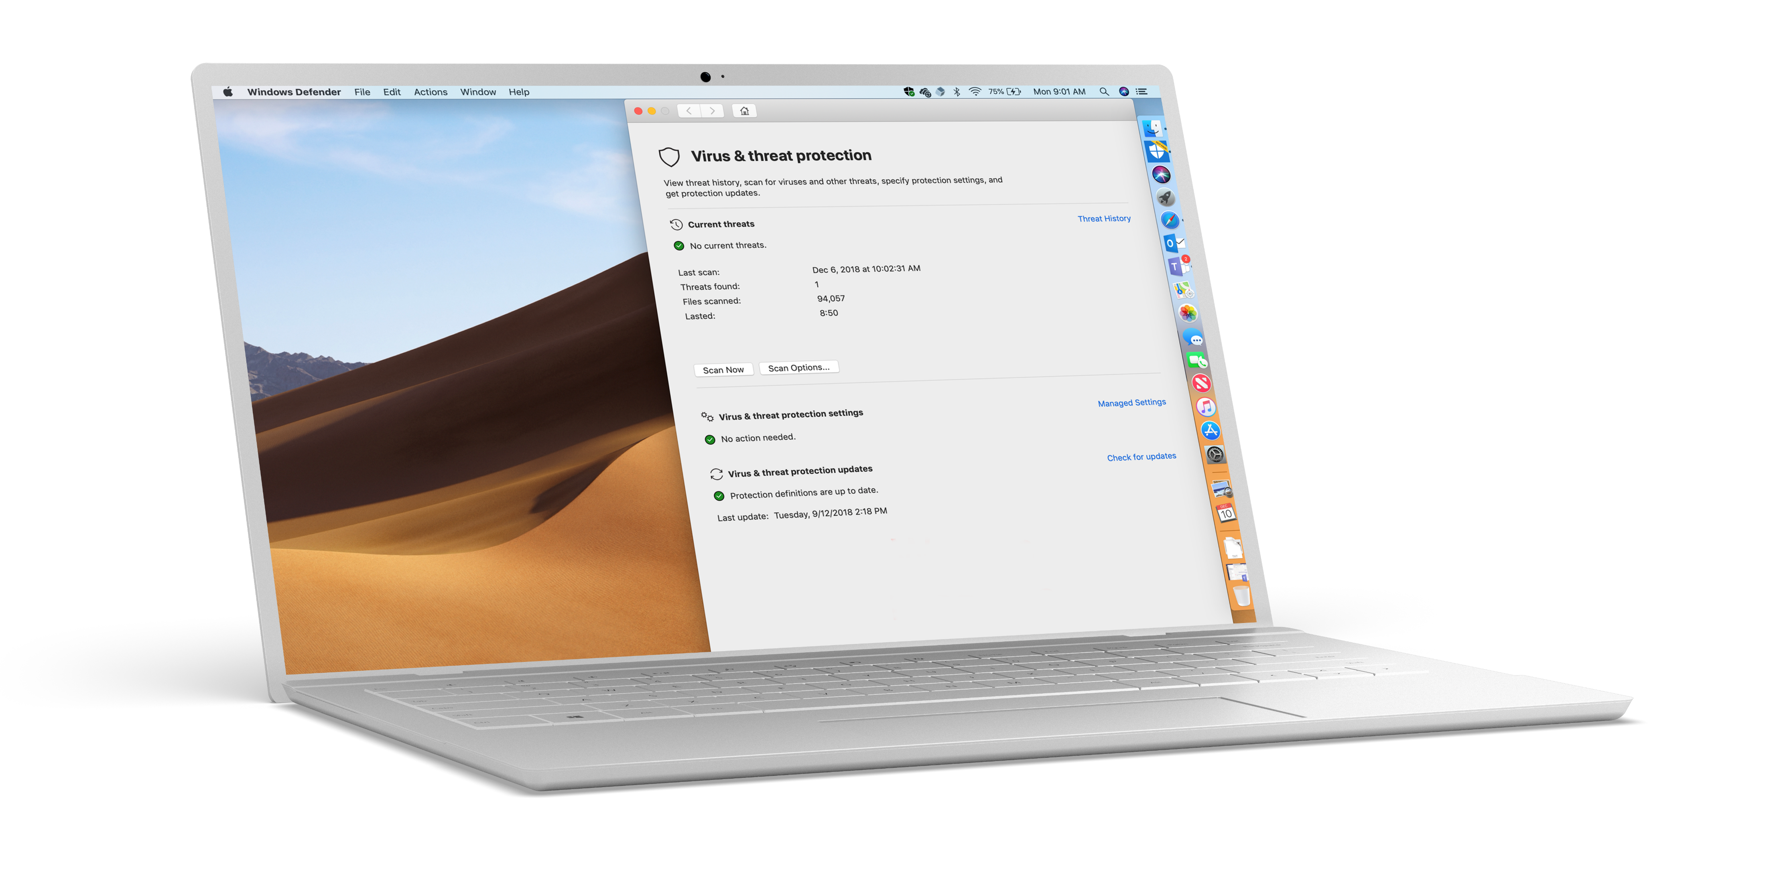


Cross-platform coverage by Microsoft
Mac
Linux
iOS*

Slide 4





Microsoft Defender for Endpoint
Customer can access their own tenant data
Management
Key component of
Microsoft 365 Defender
Security Infrastructure
(SIEM / Ticketing..)
Microsoft Endpoint Manager
Service
Now
Azure Defender
Microsoft Information Protection
Microsoft Cloud App Security
Defender for Office 365
Defender for Identity
Power BI
Custom
Threat Intelligence
Endpoint events from:
Customers’ Defender for Endpoint tenant
Microsoft Defender Security Center
Graph API
Threat & vulnerability
Defender for Endpoint behaviors
& events are being collected and surfaced into a single console:
Microsoft Defender Security Center
Azure AD
Alerts
Events
Hunting
Alerts
Attack surface reduction
Actions
Reporting
Security Analytics
Events
Exploit protection
Threat & vulnerability management
Actions
Hardware-based Isolation
Custom TI
Application control
Real-time
detections
Non-Real-time detections
Network protection
Auto investigation
and remediation
Firewall
All these behaviors & events
are used for:
Visibility, Reporting
Investigation, Hunting
Automated investigation & response
Event correlation, Detections
Threat & vulnerability management
Signal exchange
Security analytics
Browser protection
ML & Security Analytics
Observed behaviors/event
Next-gen AV protection
EDR behavioral sensors
Notification services
Detonation chamber for deep file analyses
EDR response controller
Microsoft
Threat Experts
Update service

Slide 5

In the life of a SecOps
Eval Lab
Review the attack
Alerts / Incident
Automation
Machine timeline
Advanced hunting
Response actions
Detonation
Threat Analytics

Slide 6
Become a
Microsoft Defender for Endpoint Ninja
🐱‍👤
https://aka.ms/mdatpninja

